Slide 1

Writing on Demand
Guidelines and Introduction
Freshman English Team Rules!!!

Slide 2

What is a Writing On-Demand?
A 3-5 paragraph essay that argues or explains a point and provides evidence to support that argument.
The essay can be timed OR untimed.
You must annotate 1 or more articles before your begin writing.
You will use the information from the articles in your paper to support your argument or opinion.
The essay will be in MLA format. It may be hand written or typed.

Slide 3
Steps to completing a WOD
These may vary depending if the essay is timed or un-timed.
  Dissect/Annotate Prompt
  Annotate Article(s)
  Find Quotes to use in your paper
  Write your thesis statement
  Complete a Prewrite Worksheet
  Write Rough Draft
  Edit
  Final Copy

Slide 4

Introduction
This paragraph introduces the topic and provides a roadmap for the rest of the paper. Introduction is 2-4 sentences in length.
What do you need to include?
  Hook - Attention grabbing sentence
  Thesis Statement – 1 sentence that explains your argument/stance

Slide 5
Hook Advice
Shocking statements – a startling statement can attract people easily to join the conversation.
Scene hook – the scene hook instantly instructs the mind of the reader to picture the scene.

Slide 6
Hook Advice
Literary quote hooks –Certain quotes from popular works such as Romeo and Juliet could become really nice hooks especially when the theme of the essay is a utopian one.
Humorous hook –You can use some humor in your essay by simply providing a statement that is ridiculously funny or absurd. Adding humor into your work makes the article more exciting and develops the reader’s interest into the topic.

Slide 7
Thesis Statement Advice
How to Generate a Thesis Statement if the Topic is Assigned
Almost all assignments, no matter how complicated, can be reduced to a single question.
For example, if your assignment is, “Write a report to the local school board explaining the potential benefits of using computers in a fourth-grade class,” turn the request into a question like, “What are the potential benefits of using computers in a fourth-grade class?”

Slide 8
Thesis Statement Advice
Q: “What are the potential benefits of using computers in a fourth-grade class?”
A: “The potential benefits of using computers in a fourth-grade class are . . .”
OR
A: “Using computers in a fourth-grade class promises to improve . . .” (better option)
The answer to the question is the thesis statement for the essay.

Slide 9

Introduction Example
Could you image having toxic chemicals poured on you to see what would happen? Medical research facilities conduct horrendous experiments on animals to find out their effects of their products. Animals should not be used in medical research because of the inhumane treatment administered and the overabundance of data collected.
Topic and
Opinion
Reasons – these will be explained in the body.

Slide 10
What is Annotating?
an·no·tate
/ˈanəˌtāt/
verb
1. add notes to (a text or diagram) giving explanation or comment "documentation should be annotated with explanatory notes" synonyms: comment on, add notes/footnotes to, gloss, interpret, mark up

Slide 11

First Steps of Annotating
Number the paragraphs or “chunks” of text
Take a look at the title/author/publisher/date of publication
Make predictions
Question Reliability of Source

Slide 12
What To Look For
As you read through the text, mark anything that you think is:
A. confusing
B. interesting
C. surprising
D. Important quotes you can use as EVIDENCE that will support your thesis statement! (GOLD)

Slide 13
How You Will Be Graded…

Slide 14
Suggested Coding

Slide 15
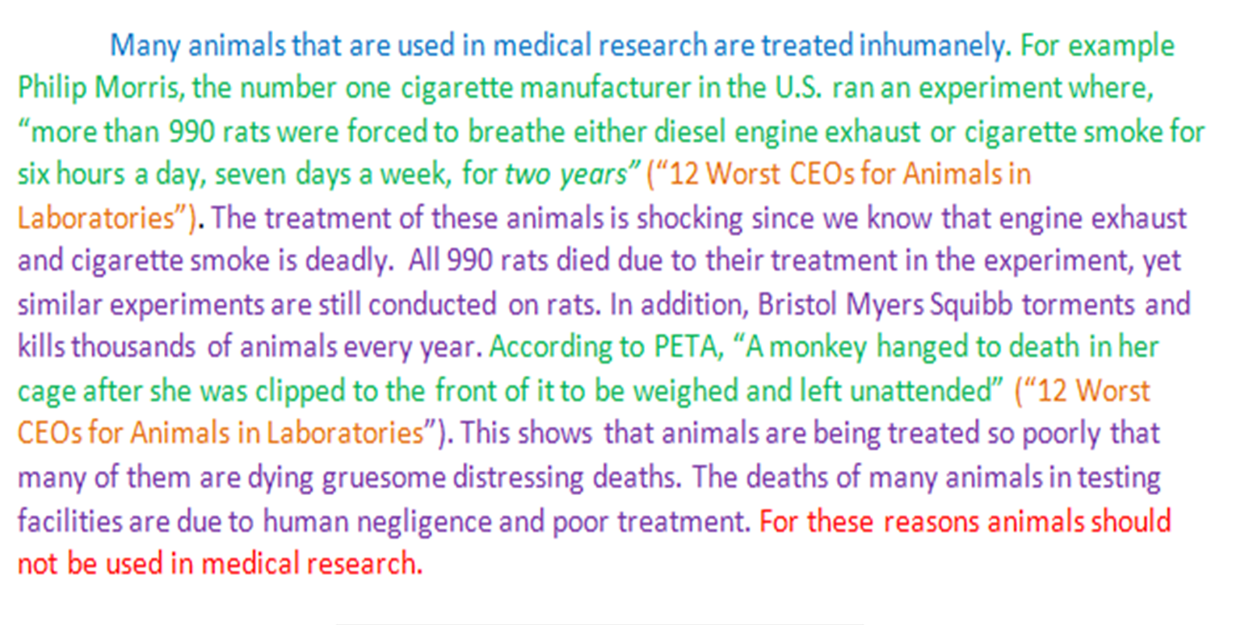
Finding Evidence
A “traditional” WOD body paragraph requires a minimum of 2 pieces of textual evidence

Slide 16
Be Picky! You Want the BEST EVIDENCE POSSIBLE!
While annotating highlight THE BEST pieces of evidence that will support your thesis (be picky… this should NOT turn into a coloring assignment)
LET’S PRACTICE!
When viewing the next slide, try to pick the BEST 2 pieces of evidence that would support the following thesis statement starter:
Distracted driving is one of the most dangerous threats to Americans because…

Slide 17
Each day in the United States, more than 9 people are killed and more than 1,153 people are injured in crashes that are reported to involve a distracted driver. Distracted driving is driving while doing another activity that takes your attention away from driving. Distracted driving can increase the chance of a motor vehicle crash.
There are three main types of distraction:
Visual: taking your eyes off the road;
Manual: taking your hands off the wheel; and
Cognitive: taking your mind off of driving.
Distracted driving activities include things like using a cell phone, texting, and eating. Using in-vehicle technologies (such as navigation systems) can also be sources of distraction. While any of these distractions can endanger the driver and others, texting while driving is especially dangerous because it combines all three types of distraction.

Slide 18
How Would We Use/Cite This?
“more than 9 people are killed and more than 1,153 people are injured in crashes that are reported to involve a distracted driver”
__________________ “more than 9 people are killed and more than 1,153 people are injured in crashes that are reported to involve a distracted driver”( ).
HINT: From online article titled “Distracted Driving” with no author provided

Slide 19
Quotation/Evidence Rules
Quotations must be tied to your sentences and your ideas
Never suddenly appear out of nowhere
Must be introduced
Never use a quotation as a complete sentence by itself
Scout describes Walter Cunningham. “Walter looked as if he had been raised on fish food: his eyes, as blues as Dill Harris’s, were red rimmed and watery” (23).”
What is wrong with this example?

Slide 20
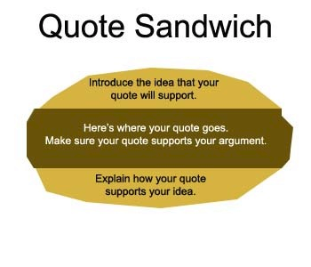
Quotation/Evidence Rules
Quotes DO NOT replace your original ideas
You must explain the significance of the quotes you used- do not do a “hit and run”
You MUST introduce your quotes AND follow up with analysis!

Slide 21
Use POWER VERBS
__________________ “more than 9 people are killed and more than 1,153 people are injured in crashes that are reported to involve a distracted driver”( ).
HINT: From online article titled “Distracted Driving” with no author provided
A few to choose from…
informs us, alleges, writes, claims, states

Slide 22
Rules for Citing
Example of Parenthetical Citation – Known Author
According to the website The People for the Ethical Treatment of Animals, the author of the article argues, “One reason may be that animals are routinely given growth-hormones, antibiotics, and even pesticides, which remain in their flesh and are passed on to meat-eaters” (Smith 2).

Slide 23
Rules for Citing
Example of Parenthetical Citation – Unknown Author, Use Article Title in Quotes
According to The People for the Ethical Treatment of Animals website, an article dedicated to improving animal treatment argues, “One reason may be that animals are routinely given growth-hormones, antibiotics, and even pesticides, which remain in their flesh and are passed on to meat-eaters” (“Vegetarianism”).

Slide 24


Annotating a Visual with OPTIC
Annotate
Overview-in one complete sentence, what is this image about?
Parts—Details: color, figures, textures, scenery, groupings, shadings, patterns, numbers, etc.
Title--What does the title suggest?
Inter-relationships--how the parts come together to create a mood or convey an idea or argument.
Conclusion--about the image as a whole: think about what the creator might be trying to express and what ideas or arguments this image presents.

Slide 25

Body Paragraphs
These paragraphs are the meat of your paper and will take the longest to write. These should connect back to your thesis statement and should contain quotes from the articles you read. Each paragraph will be at least 8 sentences long.
What do I need to include?
  Topic sentence
  Quotes from the articles (2 per paragraph)
  In-text citations
  Explanation for EACH quote
  Concluding sentence

Slide 26
Sentence Order for Body Paragraphs
Sentence 1= Topic sentence
Sentence 2= Textual Evidence - Embed quote/ include parenthetical citation
Sentence 3 and 4 =1-2 analysis sentences to explain evidence and how it supports the argument/thesis statement
Sentence 5= Textual Evidence - Embed quote/include parenthetical citation
Sentence 6 and 7=1-2 analysis sentences to explain evidence and how it supports the argument/thesis statement
Sentence 8= Conclusion sentence

Slide 27
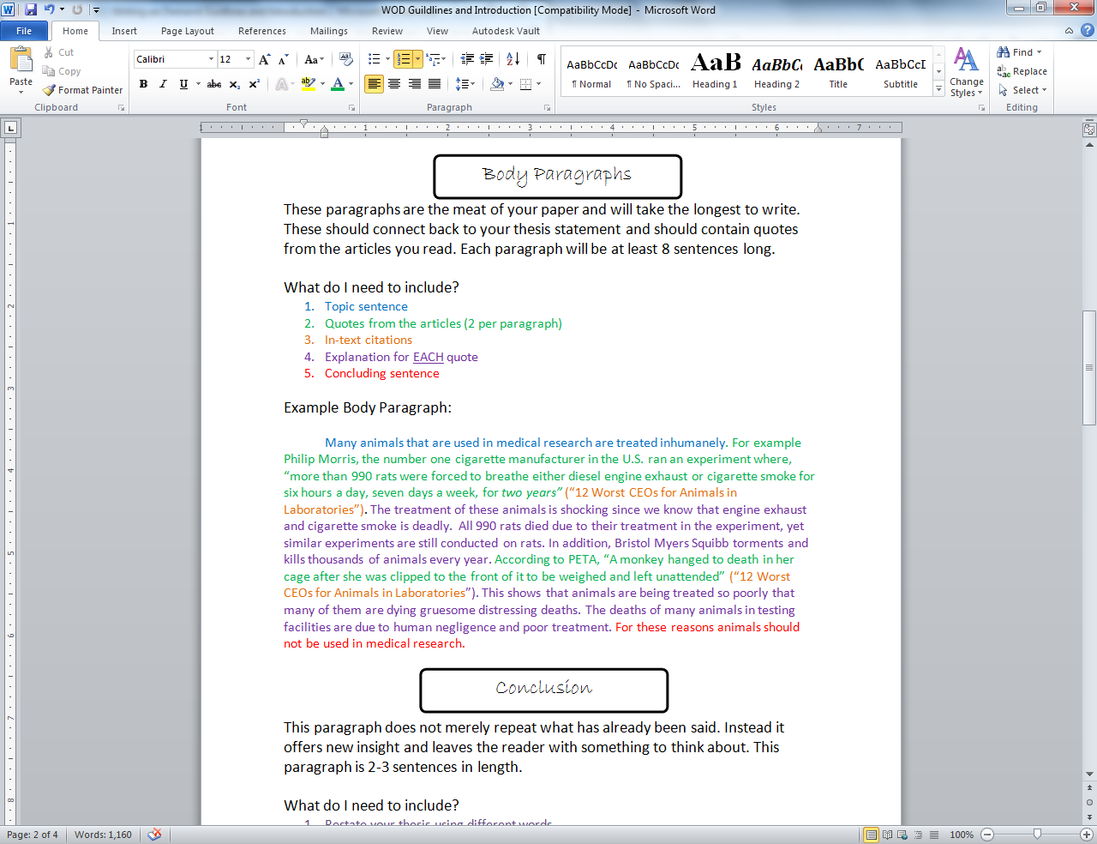
Body Paragraph Example

Slide 28

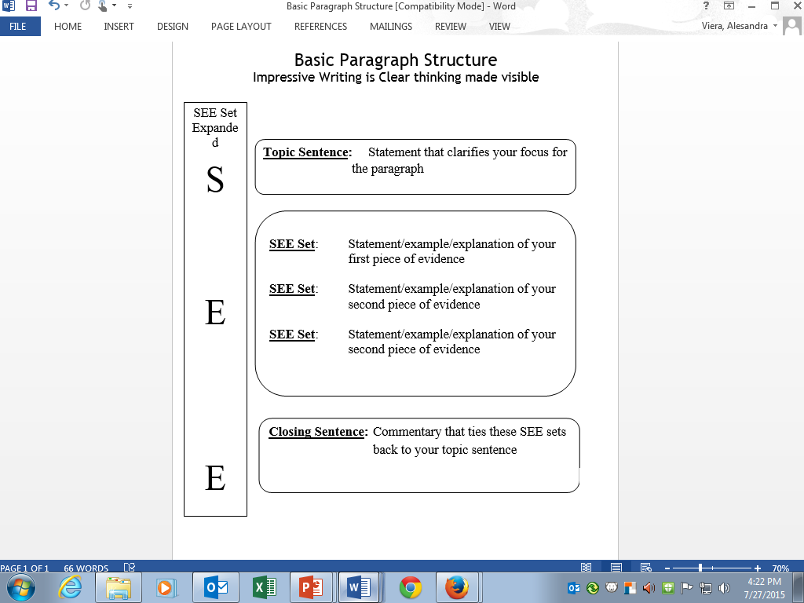
Another Way to Remember…

Slide 29
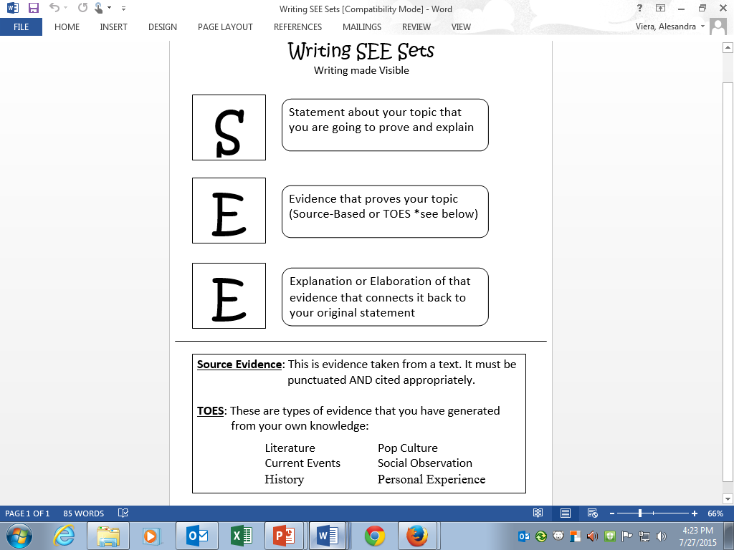
SEE SET Explained

Slide 30
Conclusion
This paragraph does not merely repeat what has already been said. Instead it offers new insight and leaves the reader with something to think about. This paragraph is 2-3 sentences in length.
What do I need to include?
  Restate your thesis using different words
  Leave the reader with something to think about.

Slide 31
Conclusion Example
    Although some products need to tested before they are used on humans, using animals in such an inhuman way is intolerable. Medical research studies need to change the way they are treating animals and new research studies need to be conducted without the use of animals.

Slide 32
Time to Review!
Get your notes ready!

Slide 33
Generally, how many paragraphs long will your “Writing on Demand” essays be?
(Hint: there is a range of length- always follow the directions your teacher gives you)

Slide 34
What is the difference between a “timed” and “untimed” essay?

Slide 35
What purpose do the articles/sources assigned with a “Writing on Demand” essay prompt serve? How are you supposed to use them?

Slide 36
What format will you need to write your “Writing on Demand” essays in?

Slide 37
What should you include in your introductory paragraph?

Slide 38
What should you include in your body paragraph(s)?

Slide 39
What should you include in your concluding paragraph?

